Slide 1
HEXATRONIC STARTING NEW AREA IN QGIS

Slide 2
Project analysis slide 2
PROCESS FLOW
AREA REQUIREMENT
PROJECT
REPROJECT FILES
MODIFY PROJECT FILE
IMPORT INITIAL FILES

Slide 3
Project analysis slide 2
PROCESS FLOW
AREA REQUIREMENT
CHECK FOR AREA REQUIREMENT.
Traditional Approach
Traditional Aerial
Traditional Underground
New Hexatronic Approach
Hexatronic Aerial
Hexatronic Underground

Slide 4
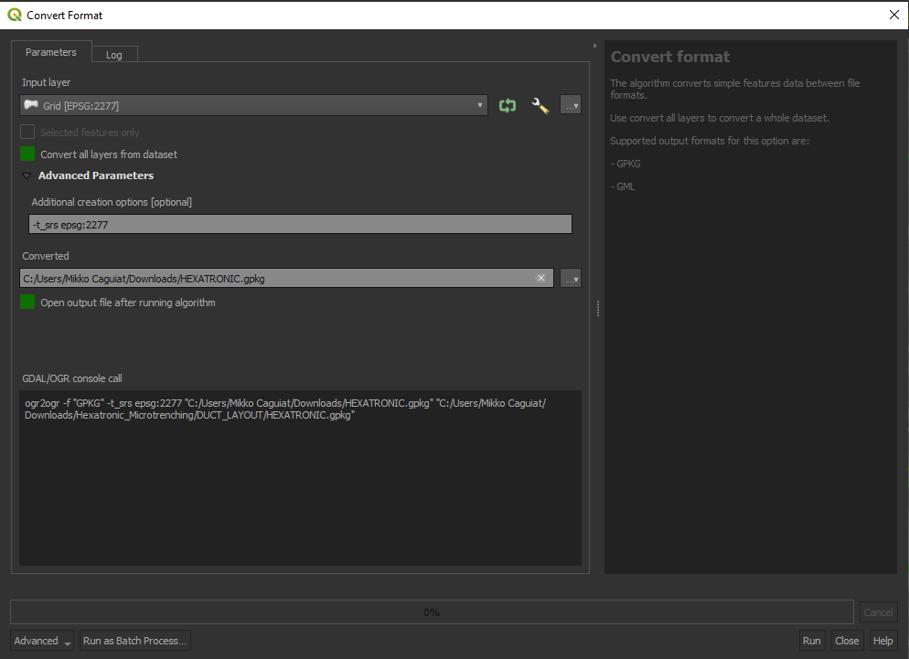
Project analysis slide 2
PROCESS FLOW
TOOL: GDAL > VECTOR CONVERSION > CONVERT FORMAT
REPROJECT FILES
Input Layer > Hexatronic.gpkg(or Traditional)
Check convert all layers from dataset.
Set projection code. i.e 2277 for TEXAS
-t_srs epsg:2277
Code should be a projected coordinate system.
Set new file gpkg for new area. Naming should be either;
HEXATRONIC.gpkg or
HEXATRONIC – Traditional.gpkg
Click Run
1
2
3
4
The geopackage should be emptied before reprojecting. i.e
Roadcenterline, Parcel, etc.,

Slide 5
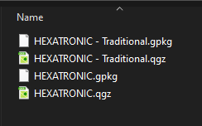
Project analysis slide 2
PROCESS FLOW
TOOL: GDAL > VECTOR CONVERSION > CONVERT FORMAT
REPROJECT FILES
5. After reprojecting. Copy and Replace the GPKG on the folder where the original file is saved. In this case DUCT_LAYOUT

Slide 6
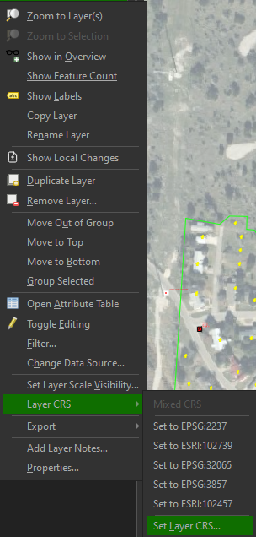
Project analysis slide 2
PROCESS FLOW
MODIFY PROJECT FILE
Open the project file.
Check all layers. If there are missing, reconnect it to the gpkg.
Set Projected Coordinate System. This is located at the bottom right on QGIS.
The CRS should be the same with the gpkg file.
4. Set All Layer CRS. This can be done by Selecting all layers, then right click,
Go to Layer CRS > then click on the assign CRS code.
4
3

Slide 7
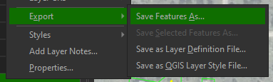
Project analysis slide 2
PROCESS FLOW
IMPORT INITIAL FILES
Initial files usually includes parcel, address, building outline, and roadcenterlines.
Once all initial files are available, we need to reproject them to the designated CRS. This can be quickly done by exporting it.
After exporting and setting the CRS, we can now, by layer, copy and paste it to its designated layers.
When done, we can now start the design phase.

Slide 8
Thank You

